Slide 1

Machine Learning and Deep Learning
Akademia Górniczo-Hutnicza im. Stanisława Staszica w Krakowie
AGH University of Krakow
Paweł Bielka, 2024-06

Slide 2
Introduction
Objective:
The goal of this project is to accurately predict energy values (Q_Heating and Q_generated) using machine learning techniques based on various input parameters. Accurate predictions can lead to better energy management and optimization in heating systems.
Importance:
Effective energy prediction helps in improving the efficiency and sustainability of energy systems, reducing costs, and enhancing the performance of heating systems. By leveraging machine learning, we can develop models that provide precise predictions based on historical data.

Slide 3
Data Source and Application Context
Data Origin: The data was sourced from a real-world natural gas pressure reduction station,where the application of a device converting the energy of moving gas on turbine blades into usable energy is being considered.
Thermodynamic Considerations: Due to the thermodynamics of the process and the Joule-Thomson effect, the temperature significantly drops after the gas exits the station. There are specific standards and economic conditions that justify the application of such a solution.

Slide 4
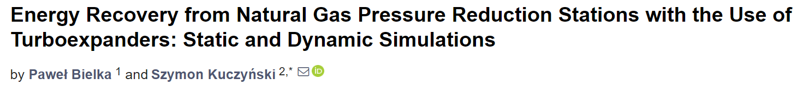
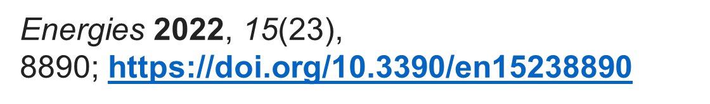
Data Source and Application Context

Slide 5
Data Source and Application Context
Exercise and Experiment Objective: The goal of this exercise was to replace time-consuming process calculations and digital twin creation in specialized process simulators, which are both time-intensive and expensive in terms of licensing.
Model Utilization: The developed model uses data already collected from measurement stations to provide predictions on how much energy will be generated under given conditions and how much heat (Q_Heating) will be required to heat the gas.

Slide 6
Model benefits
Elimination of Process Simulations: This approach eliminates the need for process simulation and purchasing licenses for specific cases and data ranges.
Efficient Predictions: The model efficiently predicts energy generation and heating requirements, streamlining the decision-making process and potentially reducing operational costs.
By incorporating real-world data and focusing on essential predictive capabilities, this model offers a practical and economically viable alternative to traditional process simulation methods.

Slide 7
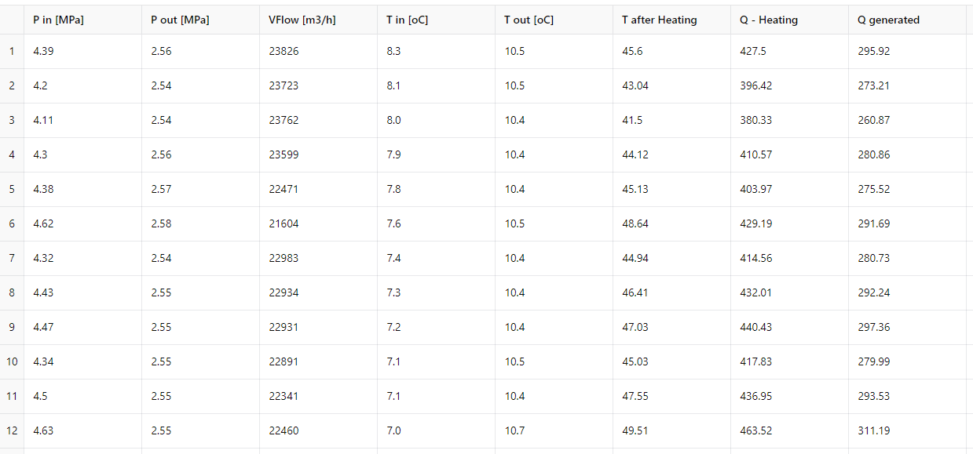
Dataset (sample)

Slide 8
Data loading and preprocessing
Data was loaded from raw Excel file(s) and preprocessed.
Libraries:
pandas, numpy: For data manipulation.
sklearn: For data splitting, scaling, model training, and evaluation.
scipy, statsmodels: For statistical analysis and outlier removal.
xgboost: For training the XGBoost model.
other: For pipeline construction and linear regression.

Slide 9
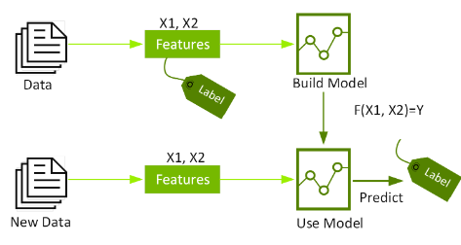
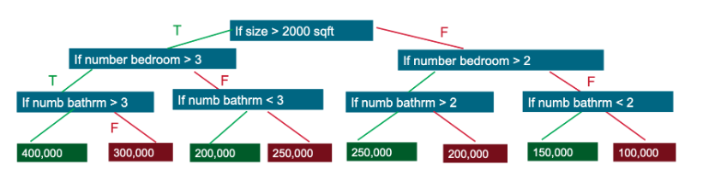
Model training & evaluation
XGBoost model with Grid Search for hyperparameter tuning.
The trained models were evaluated using RMSE (root mean squared error).

Slide 10
Why XGBoost?
Tabular Data: Ideal for structured datasets.
High Performance: Delivers high accuracy.
Large Datasets: Handles large data efficiently.
Robust: Prevents overfitting with regularization.
Fast: Optimized for speed.
Sparse Data: Manages missing values well.
Feature Engineering: Handles interactions automatically.
Ensemble Method: Combines multiple models.
Tuning: Supports extensive cross-validation.

Slide 11
XGBoost
Tabular Data: Ideal for structured datasets.
High Performance: Delivers high accuracy.
Large Datasets: Handles large data efficiently.
Robust: Prevents overfitting with regularization.
Fast: Optimized for speed.
Sparse Data: Manages missing values well.
Feature Engineering: Handles interactions automatically.
Ensemble Method: Combines multiple models.
Tuning: Supports extensive cross-validation.

Slide 12
The code
Model Training with Grid Search:
train_model: A function to train the XGBoost model using Grid Search for hyperparameter tuning. Grid Search explores the hyperparameter space to find the best settings for the model.
param_grid: Specification of the ranges of hyperparameter values to search.
Training the XGBoost Model for Each Dependent Variable:
models: A list of models trained for each dependent variable.
Model Evaluation:
mean_squared_error: Calculation of the Root Mean Squared Error (RMSE) for assessing model quality.
Predicting Values Based on User Inputs:
predict_energy: A function to predict Q_Heating and Q_generated values based on provided input values.

Slide 13
MATLAB
I have also created MATLAB code for data preprocessing and prediction. The code reads data from an Excel file, processes it by converting data types, removing missing values, and handling outliers. It then scales the data and trains a neural network model to predict heating energy output based on various input parameters. This code utilizes built-in tools such as nntraintool for Neural Network Training, enabling efficient model development and evaluation.

Slide 14
Results - Model Performance and Applicability
Both models (XGBoost and MATLAB) achieved high accuracy levels of approximately 0.02% when tested on newly generated datasets in the ASPEN Hysys process simulator for the examined technological setup.
This demonstrates the potential to bypass the ASPEN software using the created machine learning model for the given range of parameters.

Slide 15
Results - Model Performance and Applicability
Results have been uploaded to the GitHub repository: AGH_MachineLearningAndDeepLearning.
The repository also contains daily averaged datasets, the presentation, and separate MATLAB program files.

